Slide 1
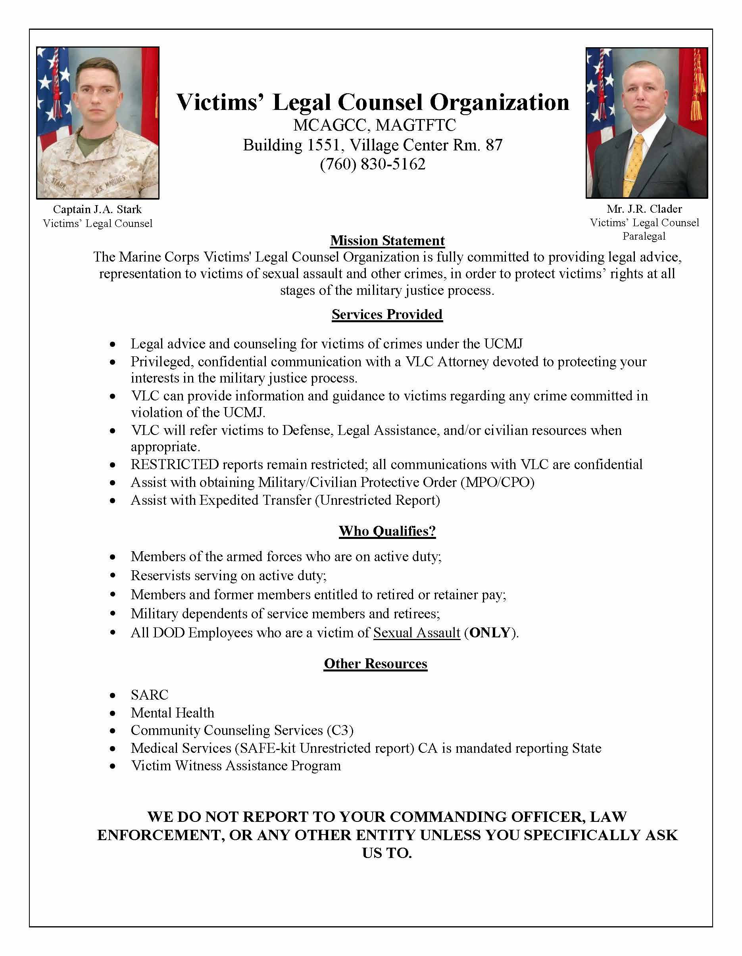
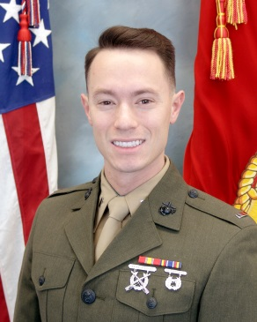
BUILDING 1417
1stLt P. N. Walters
Victims’ Legal Counsel

